Slide 1
Data Fusion Techniques to Determine Hypolith Colonization and Distribution Patterns
Eliana M. Benites and Heather L. Throop
School of Earth and Space Exploration, Arizona State University, Tempe, AZ
Notes:
Cat honors thesis: IMAGE RECOGNITION SOFTWARE REVEALS POTENTIAL FOR DETECTION OF HYPOLITH COLONIZATION IN THE NAMIB DESERT
https://docs.google.com/document/d/1cT5HQHCiZ-87ea95nmSdmmjYHpAnMVK3esH_9K9-nL8/edit?usp=sharing

Slide 2
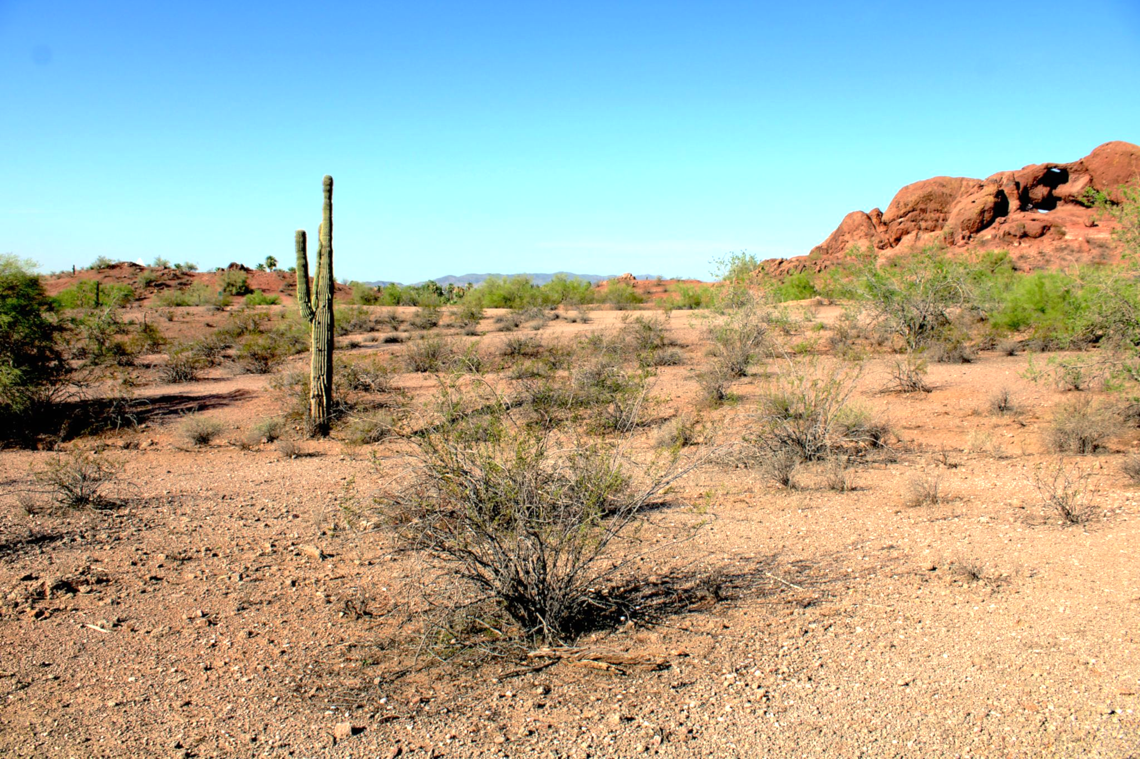
Introduction
Drylands are water-limited systems
Cover 45% of the Earth’s land surface
Characterized by the absence of water, low organic matter, high UV radiation, fluctuations of soil pH, and extreme temperatures
At the microscopic scale, microbial life can flourish within surrounding desert rocks
Severe environmental stressors influence precipitation events, evaporation, humidity, and limits the availability of water to microbial communities
This limitation generates a microbial stress-adaptive mechanism
Hypoliths are translucent to semi-translucent rocks where photosynthetic cyanobacteria and other microorganisms occupy the underside
Microbes utilize rocks for protection from the harsh environmental conditions
Notes:
Soil microbes can inhabit the top layers of surface soils and provide critical ecosystem services. In regions where plant biomass is sparse, hypolithic microbial communities can account for substantial photosynthetic biomass and provide ecosystem services such as soil stabilization and biogeochemical cycling. Uncovering hypolith distribution patterns will reveal critical information about dryland ecosystem structure and function.

Slide 3
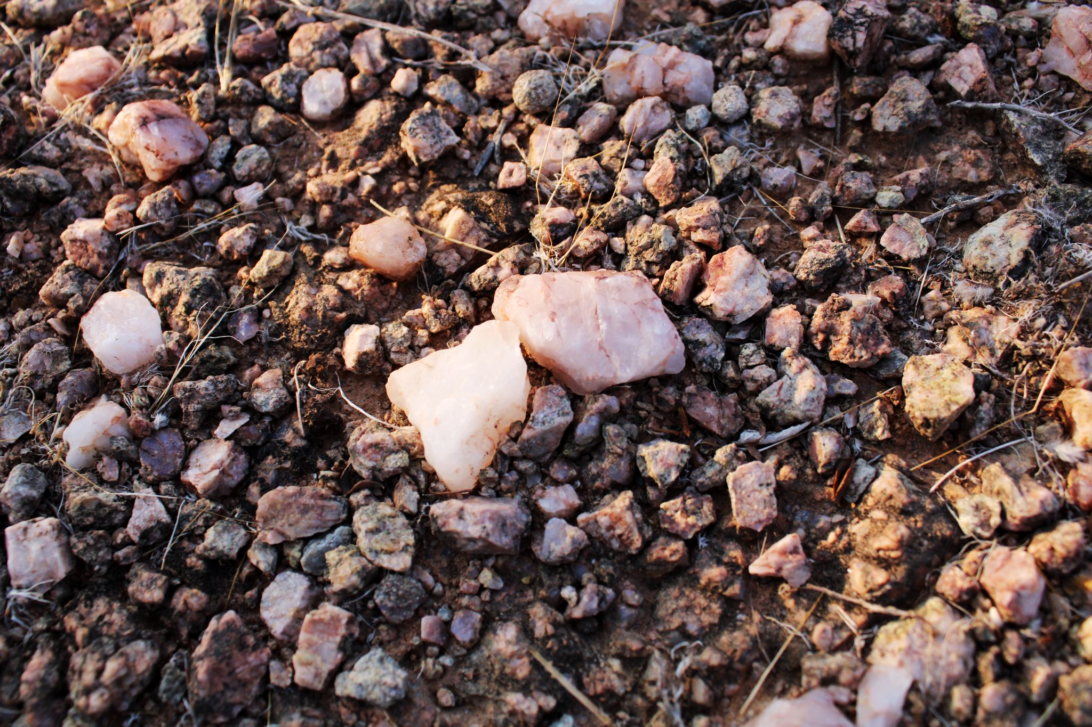
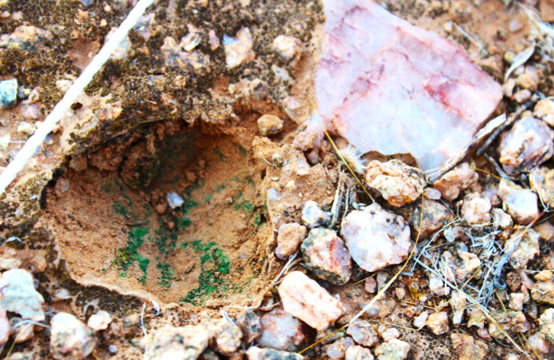
Question & Objectives
Research regarding the traits and distribution of hypolithic communities and how they vary in the Sonoran Desert remains largely unexplored.
Develop novel methods for automated estimation of broad spatial scale hypolith distribution leveraging off-the-shelf equipment.
Understand hypolith distribution at a broader scale to provide insight to the relationships between soil stability and total surface area of hypoliths.
Uncovering hypolith distribution patterns will reveal critical information about dryland ecosystem structure and function.

Slide 4
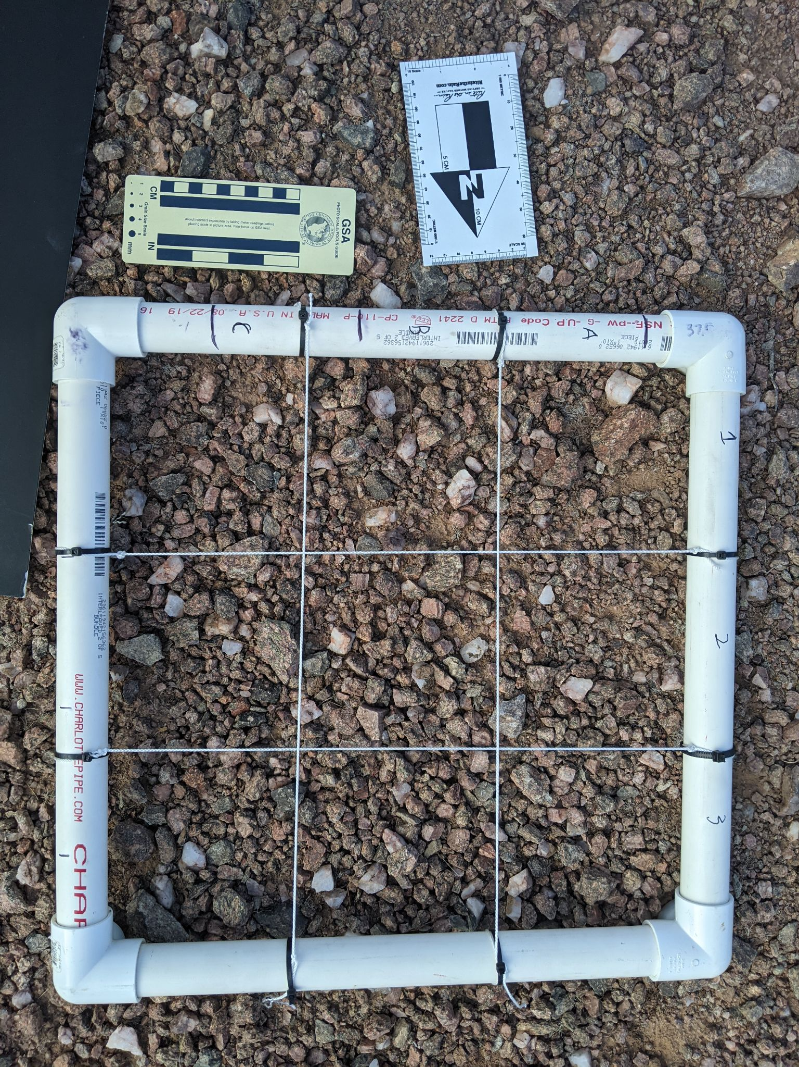
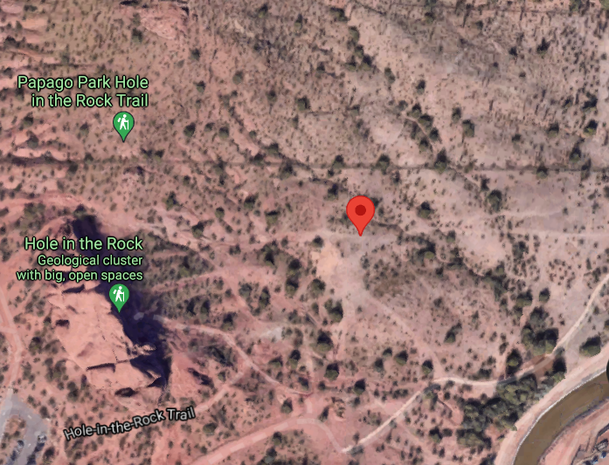
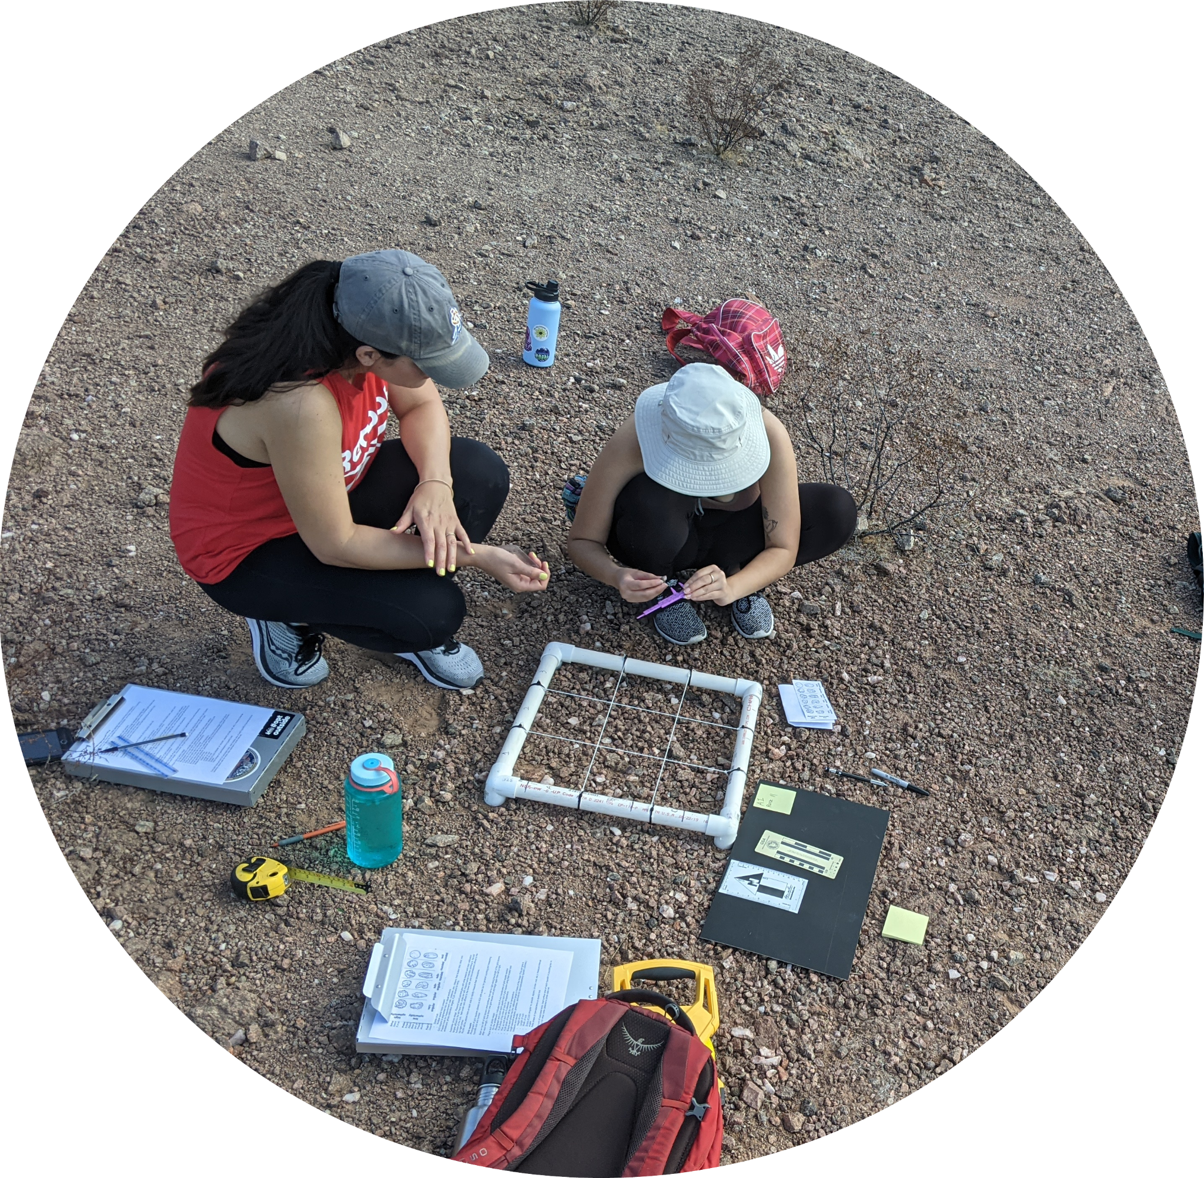
Methods
Selected 6 sites at Papago park (PAPA) and 6 sites at Desert Botanical Garden (DBG) in the Sonoran Desert (total 12)
Determine area of interest (AOI)
Stable crust and multiple quartz rocks
Place grid square on AOI (0.5m x 0.5m) in a plot of 4.5m x 4.5m
Photo of grid square placed on AOI
Photograph, tag, and count each quartz rock in grid square (using field scaled card)
https://goo.gl/maps/7xHySD3zoUX73BFb8
Field Site: Papago Park (33°27'24.8"N 111°56'37.5"W)
Notes:
Defining traits
Clast properties
Length of rock
Width of rock
Height of rock
Colonization height
Color
Milky vs translucent quartz rocks
Defining distribution
Spatial distribution of quartz rocks within a predetermined area
Percent cover and percent colonized
Clasts colonized – ratio of clasts colonized to uncolonized within a given area
Prepare tools for measurement: notebook, pen, calipers, field scaled card, sticky notes, mini whiteboard, DSLR/iphone camera, string for grid square sections, iPad
with scale bar for digital tagging and measuring hypolith size

Slide 5
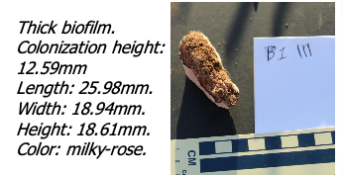
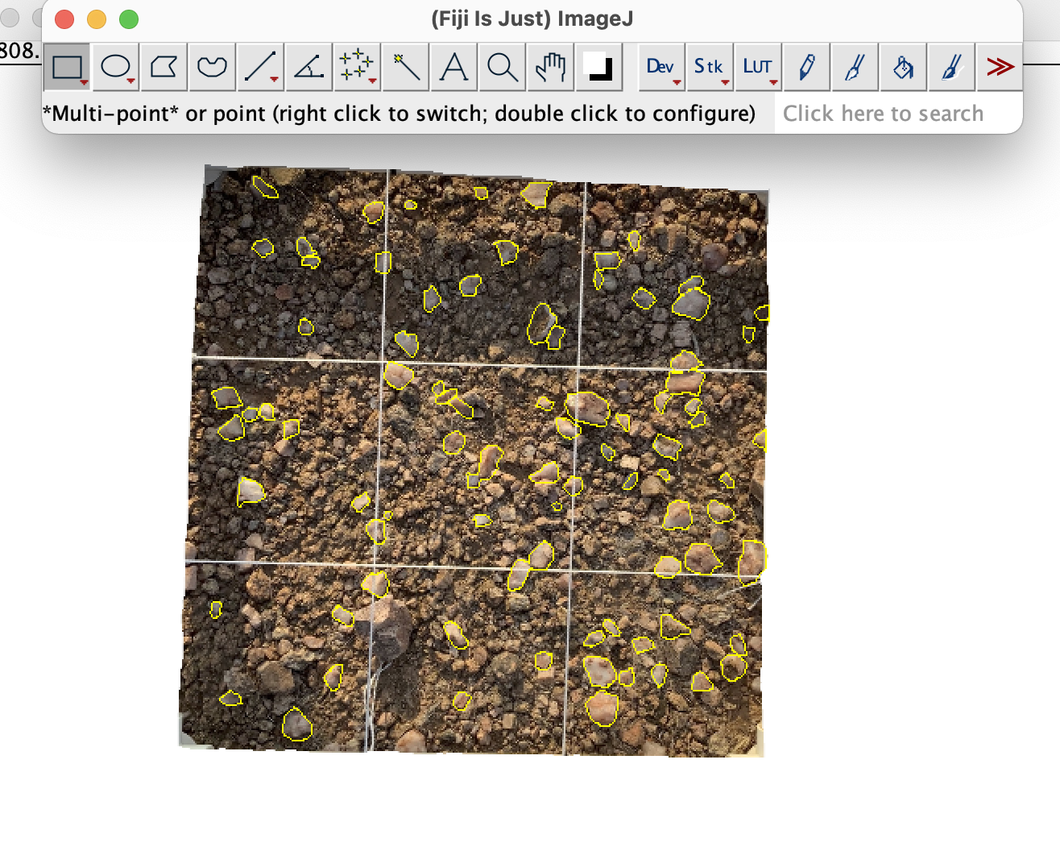
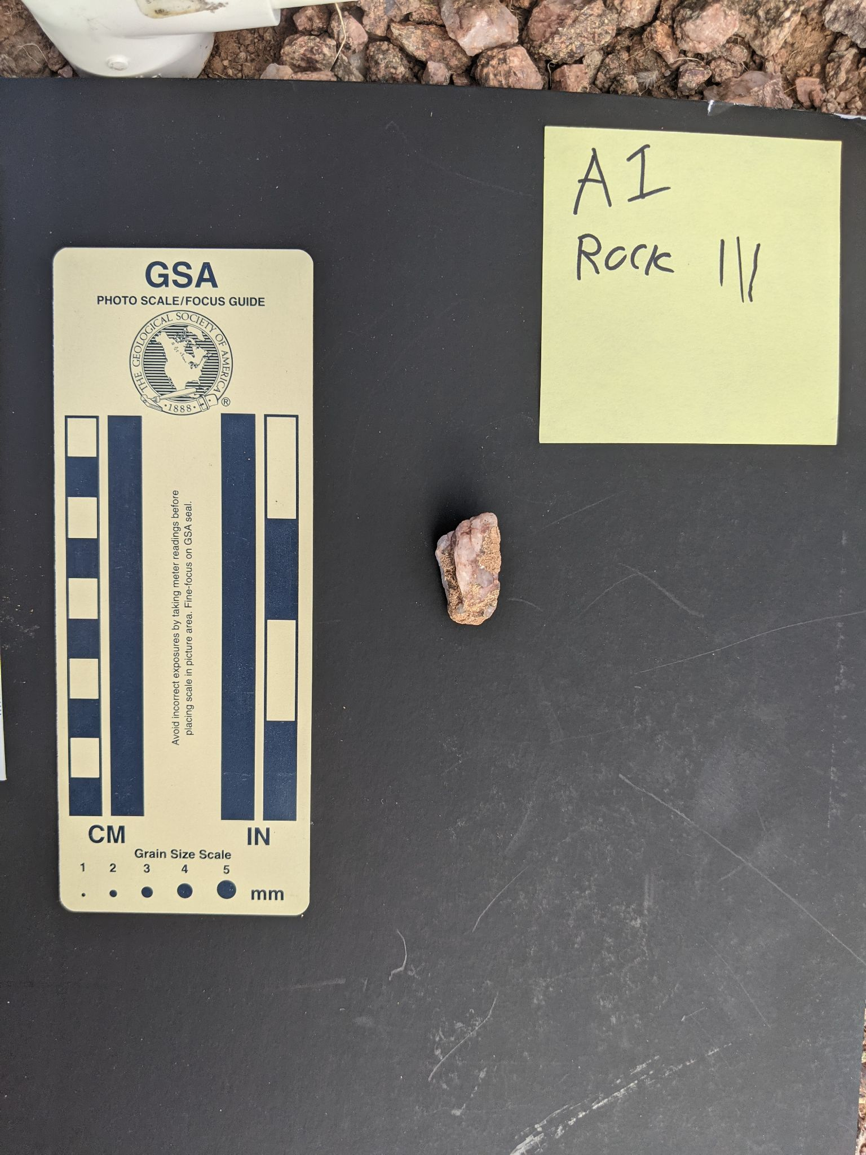
Methods of ~680 quartz rocks

Slide 6
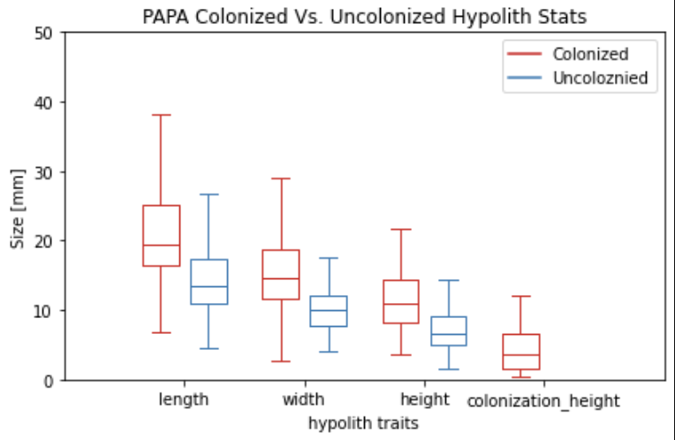
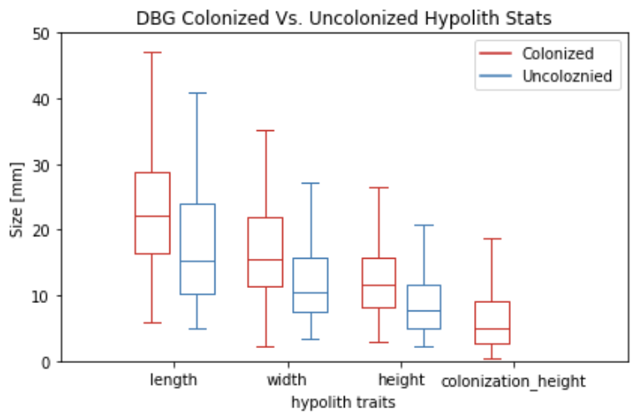
Preliminary Results - PAPA VS DBG
Fig. 1. Comparison of hypolith traits (mm) between PAPA and DBG colonized/uncolonized quartz rocks. PAPA is heavily visited by tourists. DBG is within a restricted gated area.

Slide 7
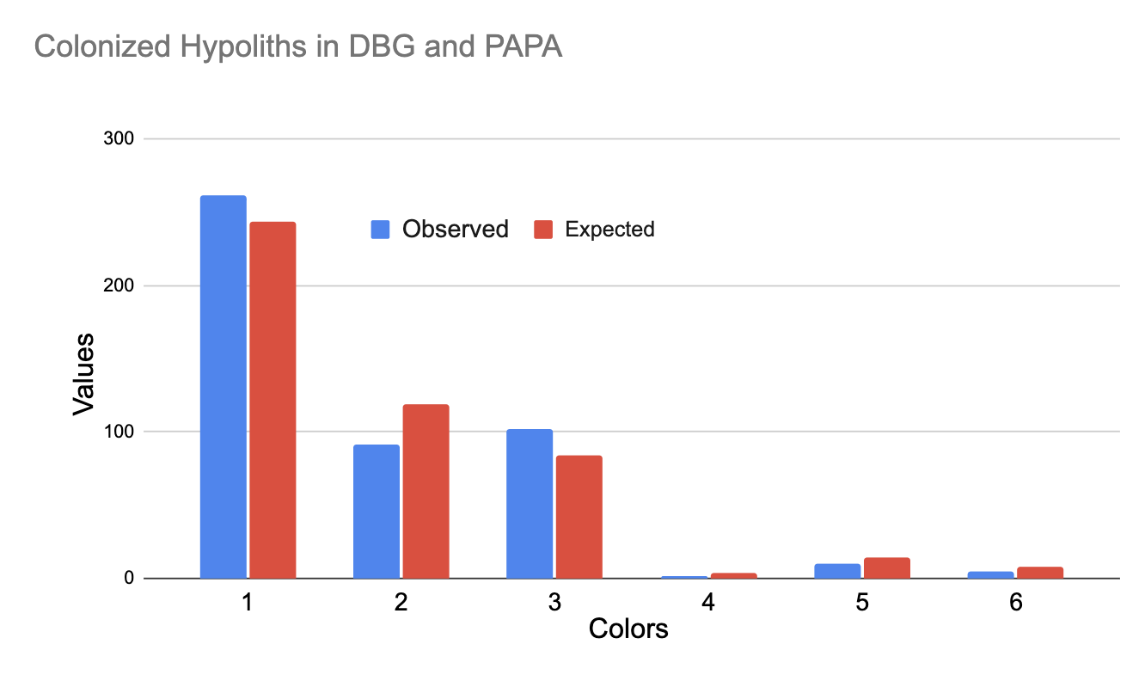

Preliminary Results
(1) Milky rose
(2) milky
(3) translucent milky
(4) translucent
(5) translucent rose
(6) rose
Fig. 2. Demonstrates observed versus expected quartz rock colors of colonized rocks in all 12 plots.

Slide 8
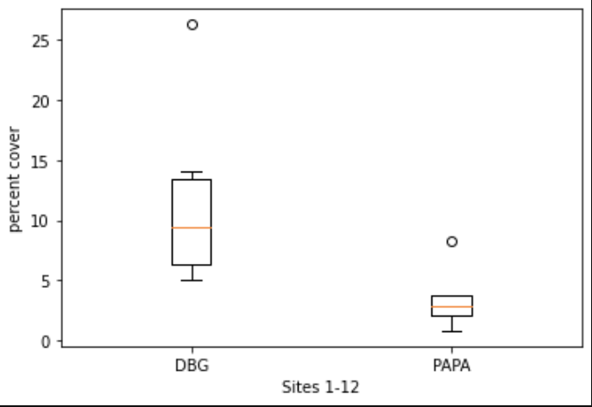
Next Steps and Discussion!
In process of determining percent cover of colonized rocks and comparing the results with percent cover of total quartz rocks.
Understanding hypolithic communities at a broader scale provides insight to the relationships between ecosystem function and the extreme boundary conditions under which life can thrive.
Fig. 3. Demonstrates percent cover of all quartz rocks in all 12 plots. Percent Cover = total area of quartz rocks in AOI / total area of AOI x 100.

Slide 9





Acknowledgements
Special thanks to Sarah R. Braunisch, Devin Keating, Dana E. Orozco, Fransiska N. Kangombe, E. N. Haupindi, F. A. Tobias, Alejandro Cueva, Jnaneshwar Das, Ramon Arrowsmith and Heather L. Throop.
Special thanks to the Dryland lab at ASU, the Desert Botanical Garden, and collaborators at UNAM and NUST. Funding was provided by NSF OISE 1854156, NASA Space Grant Program, and the Arizona Space Grant Consortium.

Slide 10
References
Ahlström, A., Raupach, M.R., Schurgers, G., Smith, B., Arneth, A., Jung, M., Reichstein, M., Canadell, J.G., Friedlingstein, P., Jain, A.K., Kato, E., Poulter, B., Sitch, S., Stocker, B.D., Viovy, N., Wang, Y.P., Wiltshire, A., Zaehle, S., Zeng, N., 2015. The dominant role of semi-arid ecosystems in the trend and variability of the land CO2 sink. Science 348, 895–899. https://doi.org/10.1126/science.aaa1668
Blaire Steven, La Verne Gallegos-Graves, Jayne Belnap, Cheryl R. Kuske, Dryland soil microbial communities display spatial biogeographic patterns associated with soil depth and soil parent material, FEMS Microbiology Ecology, Volume 86, Issue 1, October 2013, Pages 101–113, https://doi.org/10.1111/1574-6941.12143
Cavicchioli, R. et al. Life and applications of extremeophiles. Environmental Microbiology (2011). doi:10.1111/j.1462-2920.2011.02512.x
Chan Y, Lacap DC, Lau MC, Ha KY, Warren-Rhodes KA, Cockell CS, Cowan DA, McKay CP, Pointing SB (2012) Hypolithic microbial communities: between a rock and a hard place. Environ Microbiol 14:2272–2282
Kristjánsson, J.K., Hreggvidsson, G.O. Ecology and habitats of extremophiles. World Journal of Microbiology & Biotechnology 11, 17–25 (1995). https://doi.org/10.1007/BF00339134
Vásquez-Dean, J., Maza, F., Morel, I. et al. Microbial communities from arid environments on a global scale. A systematic review. Biol Res 53, 29 (2020). https://doi.org/10.1186/s40659-020-00296-1
Yanagawa, K., Ijiri, A., Breuker, A. et al. Defining boundaries for the distribution of microbial communities beneath the sediment-buried, hydrothermally active seafloor. ISME J 11, 529–542 (2017). https://doi.org/10.1038/ismej.2016.119

Slide 11
Thank you!

